Slide 1
The Phases of a Compiler
&
Compiler Project
Prof. Abdelaziz Khamis

Slide 2
Compiler Project - Topics
The Phases of a Compiler
The TINY Sample Language
The TINY Compiler
The TM Machine
C-Minus: A language for a Compiler Project
Prof. Abdelaziz Khamis

Slide 3
The Phases of a Compiler
A compiler consists of a number of steps, or phases, that perform distinct logical operations.
The phases of a compiler are shown in the given figure, together with three supporting components that interact with some or all of the phases.
Source Code
Scanner
Tokens
Parser
Syntax Tree
Semantic
Literal
Analyzer
Table
Symbol
Annotated
Tree
Table
Source Code
Error
Optimizer
Handler
Intermediate
Code
Code
Generator
Target
Code
Target Code
Optimizer
Target
Code
Prof. Abdelaziz Khamis

Slide 4
Extended Example
The Scanner: This piece of the compiler performs what is called lexical analysis: it receives the source code in the form of a stream of characters and divides it up into meaningful units called tokens.
  Source code: a[index] = 4 + 2
  Tokens: ID Lbracket ID Rbracket AssignOp Num AddOp Num
  A scanner may perform other operations along with the recognition of tokens. For example, it may enter identifiers into the symbol table, and it may enter literals (numeric constants and quoted strings)
  into the literal table.
Prof. Abdelaziz Khamis

Slide 5
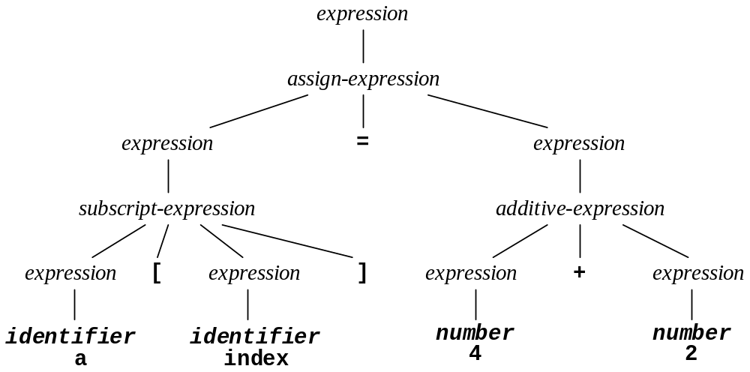
Extended Example (Continued)
The Parser: This piece of the compiler performs what is called syntax analysis: it receives the source code in the form of tokens and determines the structure of the source code represented as a parse tree or a syntax tree.
Prof. Abdelaziz Khamis

Slide 6
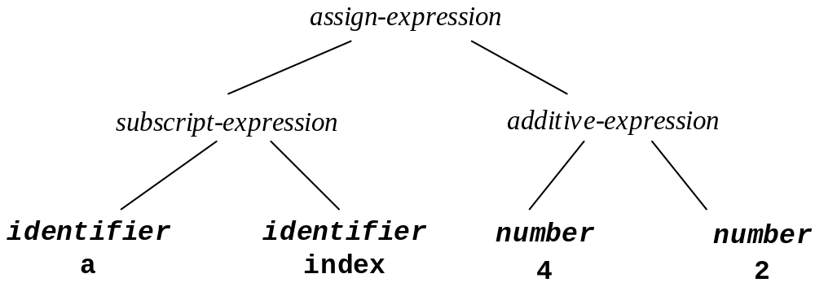
Extended Example (Continued)
A parse tree is a useful aid to visualizing the syntax of a program or program element, but it is inefficient in its representation of that structure.
Parsers tend to generate a syntax tree instead, which is a “neat” version of the parse tree with only essential information.
Prof. Abdelaziz Khamis

Slide 7
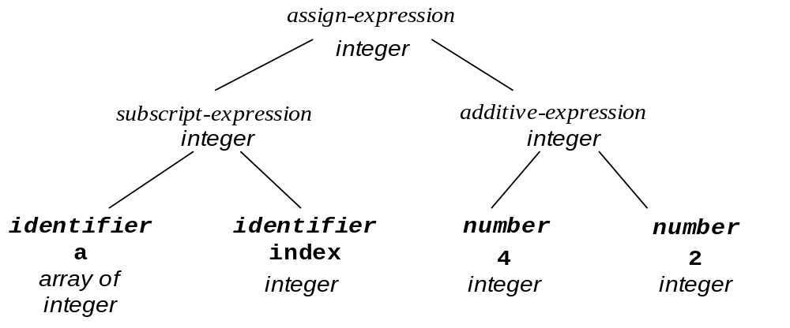
Extended Example (Continued)
The Semantic Analyzer: This piece of the compiler performs what is called semantic analysis: it computes additional information, called attributes, needed for compilation once the syntactic structure of a program is known.
These attributes, such as data types, are often added to the syntax tree. They may also be entered into the symbol table.
Prof. Abdelaziz Khamis

Slide 8
Extended Example (Continued)
The Source Code Optimizer: This piece of the compiler generates intermediate code/representation (such as three-address code) from the syntax tree that is more closely resembles target code.
In our example, three-address code for the original C expression might look like this:
  t = 4 + 2
  a[index] = t;
Now the optimizer would improve this code in two steps, first computing the result of the addition and then replacing the temporary variable t by its value to get the three-address code
  a[index] = 6
Prof. Abdelaziz Khamis

Slide 9
Extended Example (Continued)
The Code Generator: This piece of the compiler takes the intermediate code/representation and generates code for the target machine.
In this course we will write target code in assembly language form for ease of understanding, although most compilers generate object code directly.
A possible sample code sequence for the given expression might be (in a hypothetical assembly language)
  MOV R0, index ;; value of index → R0
  MUL R0, 2 ;; double value in R0
  MOV R1, &a ;; address of a → R1
  ADD R1, R0 ;; add R0 to R1
  MOV *R1, 6 ;; constant 6 → address in R1
Prof. Abdelaziz Khamis

Slide 10
Extended Example (Continued)
The Target Code Optimizer: This piece of the compiler improves the target code by eliminating redundant or unnecessary operations, replacing slow instructions by faster ones, and choosing addressing modes to improve performance.
In the sample target code given, there are a number of improvements possible:
  Use a shift instruction to replace the multiplication
  Use indexed addressing to perform the array store
With these two optimizations, our target code becomes:
  MOV R0, index ;; value of index → R0
  SHL R0 ;; double value in R0
  MOV &A[R0], 6 ;; constant 6 → address of a + R0
Prof. Abdelaziz Khamis

Slide 11
The TINY Sample Language
A course on compiler construction would be incomplete without examples for each step in the compilation process
In this course we will use a compiler for a small language, called TINY, as a running example for the techniques that will be discussed in the compilation phases
A program in TINY has a very simple structure:
  A sequence of statements separated by semicolons
  There are no declaration and no procedures
  All variables are integer variables
  There are only two control statements: if & repeat
  An if-statement must be terminated by the keyword end
  There are read and write statements that perform input/output
  Expressions are limited to Boolean and integer arithmetic
Prof. Abdelaziz Khamis

Slide 12
TINY Example
We will use the following sample program as a running example throughout the course
    read x;
    if x > 0 then
    fact := 1;
    repeat
    fact := fact * x;
    x := x - 1
    until x = 0;
    write fact
    end
Prof. Abdelaziz Khamis

Slide 13
The TINY Compiler
The TINY compiler consists of the following files. The source code for these files is listed in Appendix B of the Refence Book.
  globals.h main.c
  util.h util.c
  scan.h scan.c
  parse.h parse.c
  symtab.h symtab.c
  analyze.h analyze.c
  code.h code.c
  cgen.h cgen.c
Prof. Abdelaziz Khamis

Slide 14
The TM Machine
We simplify the target language of the TINY compiler to be the assembly language for a simple hypothetical machine, which we will call the TM machine
The source code for a TM simulator is listed in Appendix C of the Refence Book. It reads from a file the target code produced by the TINY compiler and executes it
Exercise: Compile the TINY compiler and the TM machine simulator. Use the TINY compiler to compile the TINY sample program, and then use the machine simulator to execute it.
Prof. Abdelaziz Khamis

Slide 15
C-Minus: A language for a Compiler Project
A more extensive language than TINY, suitable for a compiler project, is described in Appendix A of the Refence Book. It is a significantly restricted subset of C, which we will call C-Minus
C-Minus has the following features:
  It contains integers, integer arrays, and functions
  It has local and global declarations and recursive functions
  It has an if-statement and a while-statement
  A program consists of a sequence of function and variable declarations
  A main function must be declared last
Appendix A provides guidance on how to modify and extend the TINY compiler to C-Minus
Prof. Abdelaziz Khamis

Slide 16
C-Minus Example
The following is a sample program in C-Minus. More examples exist in Appendix A of the Refence Book
    int fact( int x )
    { if (x > 1)
    return x * fact(x-1);
    else
    return 1;
    }
    void main( void )
    { int x;
    x = read();
    if (x > 0) write( fact(x) );
    }
Prof. Abdelaziz Khamis

